Slide 2

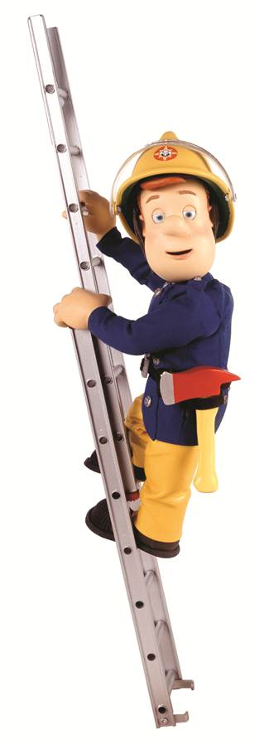
Distribution
110 territories across Europe, Africa, the Middle East & Asia
15 million subscribers
5 feeds: Pan-European, Middle East, Benelux, Poland, German
Original English language
13 dubbed languages
  English
  Romanian
  Portuguese
  Czech
  Hungarian
  Dutch
  German
  Arabic
  Swahili - 2016
  Russian
  Hebrew - 2016
  Polish
  Lithuanian

Slide 3
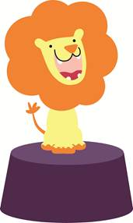
Channel Concept & Philosophy
For pre–school children, aged 1 - 6
Imaginative mix of children’s animation, sing-a-longs, story-telling, puppet and claymation programming
Trusted, inspiring and engaging – the ideal companion for parenting
Dedicated to helping grown-ups nurture their children in the most positive way
A caring and inspiring place for children to learn positive life-lessons in their formative years
Schedule broken down into 3 sections:
  Morning – energetic, lively and fun
  Afternoon and Late Night – Classic entertainment with key hit shows
  Evening – Strong story telling with calming influence.

Slide 4
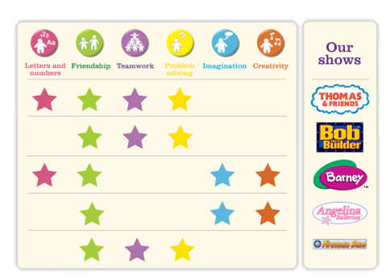
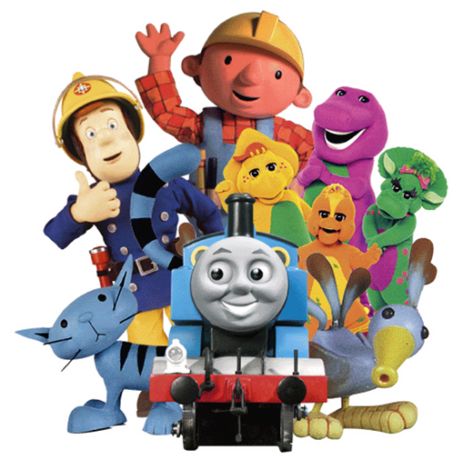
Programming
Long term programme licence with Hit Entertainment for some of the world’s favourite children’s titles:
Programming strongly contributes to the emotional
intellectual and social development of children
Ideal companion to parenting
A unique environment where child and parent/carer can grow together

Slide 5
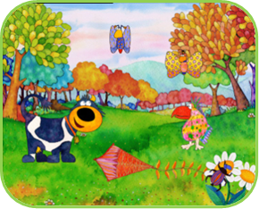
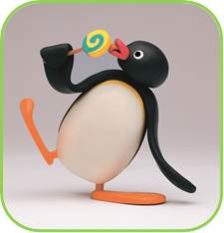
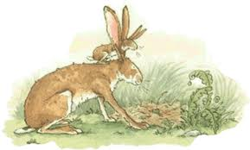
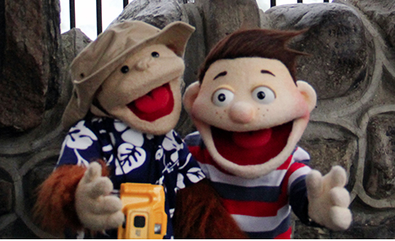
Programming
Connie the Cow
Connie is a mischievous young cow, who pokes her nose into everything, creating all sorts of problems and generally getting everybody in a muddle, as she explores the fantastic world of animals and plants around her.
Guess How Much I Love You
This is the idyllic home of Little Nutbrown Hare and his father, Big Nutbrown Hare. The series follows their adventures as they explore their beautiful surrounds, play with their friends and delight in the love between them.
Pingu
Meet Pingu, the fun loving and full of energy baby penguin that lives in the Antarctic.
He spends most of his time playing with his friend Robby the seal and his family; Mother, Father, sister Pinga and his Grandparents
Now You Know
Now You Know is an entertaining and engaging original series for kids 4-6. It enhances natural curiosity and promotes play-based learning by seeking answers to questions pre-schoolers ask about science, nature and the world around them. The series combines puppetry, animation and live-action with segments shot on location, featuring high profile personalities and experts. Now You Know explores science, nature, music, dance and language in order to educate and entertain.

Slide 6
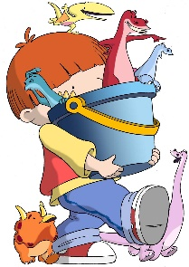
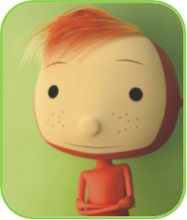
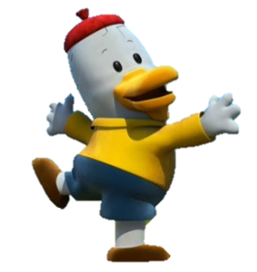
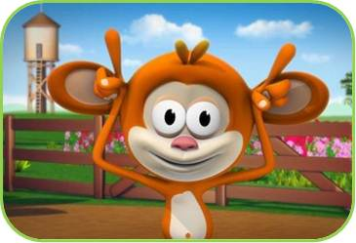
Programming
Harry
Harry knows he's the luckiest kid in the world; his Nana has given him the greatest present ever, something that no one else has. A bucket with six toy dinosaurs that come to life and are all his best friends.
What’s the big Idea (52 x 5)
Beautiful and smart philosophy for kids which poses questions such as:
Who am I? What am I? What is a pet? Is a lie always bad?
Why do people feel sad? How can we make them feel happy?
The show never tries to answer the question but instead prompts children to explore many sides of a single idea, and practice the essential life skills of questioning and reasoning. Unexpected, visual and fun!
Noksu
Things just happen to NOKSU, whose name means ‘Be yourself!'. NOKSU's natural curiosity and extrovert character propels him from one adventure to another and wherever he goes, tiny Nupi buzzes along too.
Oto & the Music
Oto is a red clay octopus, who has wide open eyes and a saucy multifunctional nose/trumpet. He can't speak, but he can express himself with movements and by means of his mimical expressions. Oto lives in a sea made up of musical notes, as music is his passion.
Monkey See, Monkey Do
Monkey, the animated host, invites children to discover, imitate and dance along with the day's animal guests in one of five different environments (Jungle, Farm, Pond, Savannah or Arctic). He is helped by his youthful human companions, who are integrated into the cartoon via CGI technology. Monkey gets kids singing, dancing and following along, using a special educational method developed by psychologists which teaches motor skills and social concepts.

Slide 7






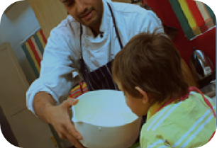
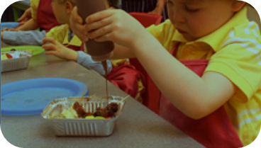
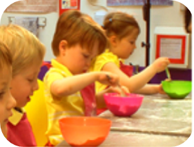
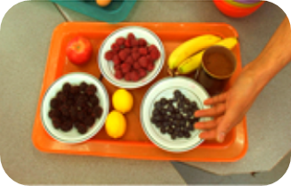
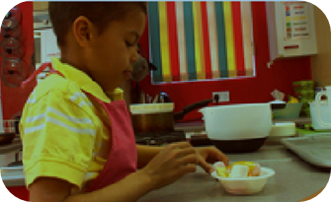
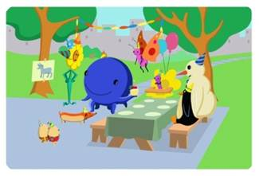
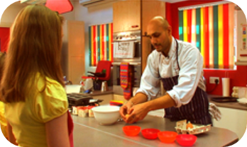
On Air Look & Interstitials
New on air themes every few months
  Zoo Jungle Space Under the Sea Farm Circus
Mix of character and live action scenes to develop recognition and assist with key learning skills
e.g. you may see images of children eating / baking mixed with images of characters also
eating / baking

Slide 8

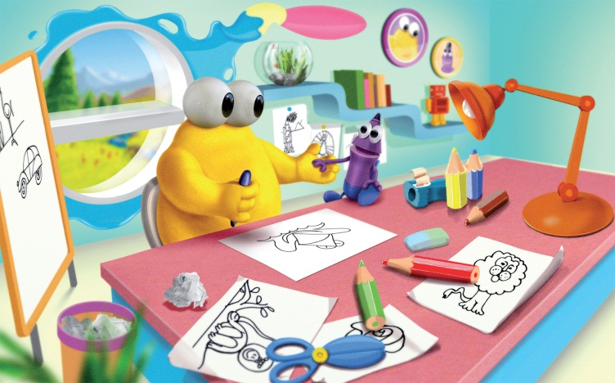
Premier Episodes - 2016
FEBRUARY
Doodleboo (11x5’)
Doodleboo is a loveable puppet character, accompanied by his friend, Pencil Head, the colored pencil. Using their unique
and playful way to teach drawing, they will awaken children’s imaginations.
The essence of the series is to show that drawing can be a game ! Using simple shapes and step-by-step instructions,
Doodleboo teaches children how to make elaborate drawings.

Slide 9

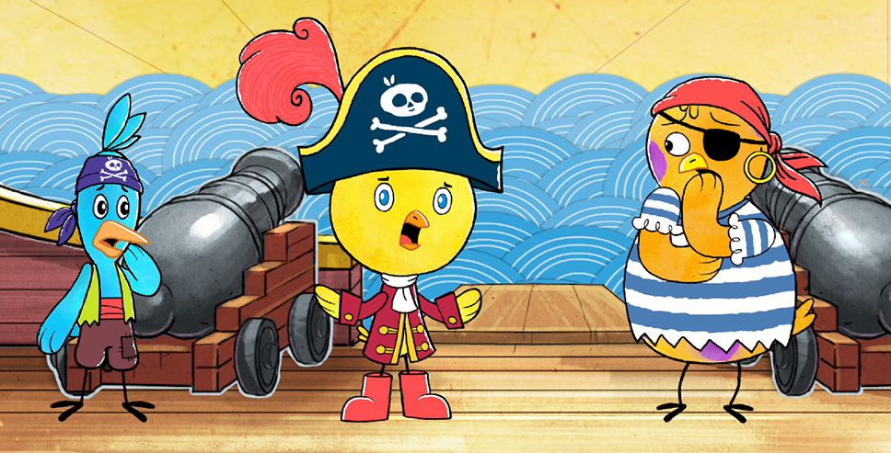
March
Premier Episodes - 2016
Chirp(26x11’)
Chirp, Squawk and Tweet are best friends who use their imaginations and everyday objects to get them in – and out of – fantastically fun adventures and hilariously sticky predicaments. Chirp, Tweet and Squawk may imagine themselves on grand quests through jungles and on spy missions, but ultimately their imaginations get them into trouble.

Slide 10
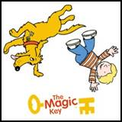
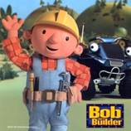

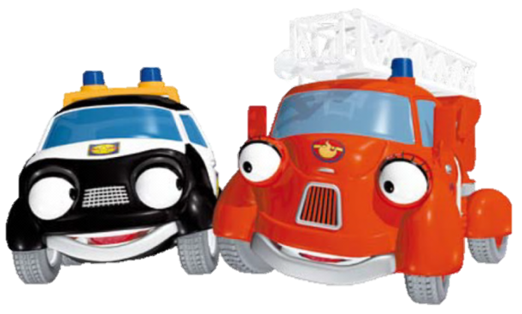
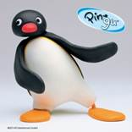
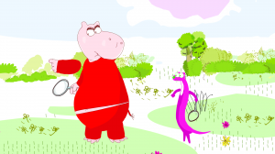



Companion VOD Service
    Up to 5 combined programming hours at a time
    Oldest episodes are refreshed each month
    FTP/Aspera file delivery
    6 month VOD schedule:
Title | Eps name | Short Synopsis
JimJam Presents, Agi Bagi (Series 1) | Ep 5 Colourful Rain | The Agingas continue the spring cleaning, and decide to renovate their village.
JimJam Presents, Bob the Builder (Series 4) | Ep 8 Farmer Pickles' Pigeon | Farmer Pickles calls by to ask Bob to build a run for Scruffty, but he drops his mobile phone.
JimJam Presents, Heroes of the City (Series 1) | Ep 8 The Airplane that Disappeared | One foggy morning, the mail doesn’t arrive. The inhabitants of the city wait patiently.
JimJam Presents, Hip Hip Hurray (series 1) | Ep 9 Where's My Cloud? | Giraffe tries to paint Hip-Hip but she cannot concentrate because the clouds are constantly changing their location, why does it happen?
JimJam Presents, Jarmies (Series 2) | Ep 21 Cards and Carrots | Tommy sees Tim and Holly playing bunny hops, so the Jarmies play bunny hops too.
JimJam Presents, Kipper (Series 4) | Ep 8 Crazy Golf | Tiger wants to show everyone how good he is at crazy golf. But he gets upset when Kipper and Arnold are better at it than him.
JimJam Presents, Monkey See Monkey Do (Series 1) | Ep 5 Frog | Monkey and the children are at the lake where Frog happily shows them how to be like him by teaching them to croak and leap.
JimJam Presents, My Animal Friends (Series 1) | Ep14 Turtle | This series explores the many wonders of our planets wildlife through the eyes of a child leaning life skills and importance of family.
JimJam Presents, Pingu (Series 2) | Ep 21 PINGU’s hospital visit | With his mother, PINGU visits the injured Pinga in hospital. PINGU manages to cheer up the whole ward by pretending to be the surgeon in a shadow play he puts on.
JimJam Presents, Thomas and Friends (Series 2) | Ep 21 The Diseasel | Some silly trucks cause trouble between Bill and Ben the tank engine twins and a diesel called BoCo. Confusion reigns until Edward puffs in.
JimJam Presents, Woody Buddies (Series 1) | Ep 8 Play Toy Bricks | In the depth of the forest there is a MuMu Tribe where mysterious and lovely baby bugs live. They enjoy sunshine, games, friendships’ and happiness. Join our friends Woody Buddies where your heart will be touched every day.
JimJam Presents, Agi Bagi (Series 1) | Ep 6 The New Forest | On Agi, the oafish Strongy is playing hide-and-seek with the Gligluks, and accidentally uproots trees.
JimJam Presents, Bob the Builder (Series 4) | Ep 9 Bob On The Run | Mrs Percival is raising money for a new sports pavilion but, despite Bob going on a sponsored run, she is still far from reaching her target
JimJam Presents, Heroes of the City (Series 1) | Ep 9 Tiger on the Loose | It is bathing day at the Zoo. Zoofi only has the little tiger Tessa left to wash when she discovers that the pasture is empty!
JimJam Presents, Hip Hip Hurray (series 1) | Ep 10 Who kidnapped the storks? | The Storks are the neighbours of the Parrots, but the Storks have disappeared.
JimJam Presents, Jarmies (Series 2) | Ep 22 Bubble Trouble | Tim and Holly are playing with a bubble machine in the garden, the Jarmies make their own bubble wand.
JimJam Presents, Kipper (Series 4) | Ep 9 Echo Echo | Kipper is confused when he finds himself having a conversation with an echo. It turns out that the ‘echo’ is a chatty bird called Henry.
JimJam Presents, Monkey See Monkey Do (Series 1) | Ep 6 Lion | Monkey and the children are at the Savannah learning to roar and act like the 'King of the Jungle' the Lion.
JimJam Presents, My Animal Friends (Series 1) | Ep15 Bears | This series explores the many wonders of our planets wildlife through the eyes of a child leaning life skills and importance of family.
JimJam Presents, Pingu (Series 2) | Ep 22 PINGU on the school trip | The class outing takes them to see a sculptor, where a huge whale is being hewn. During the visit a classmate climbs on the sculpture.
JimJam Presents, Thomas and Friends (Series 2) | Ep 22 Wrong Road | Edward suggests Gordon runs a branch line for a change. Proud Gordon the mainline engine refuses until one day he travels on a branch line by mistake.
JimJam Presents, Woody Buddies (Series 1) | Ep 9 Bowling Game | In the depth of the forest there is a MuMu Tribe where mysterious and lovely baby bugs live. They enjoy sunshine, games, friendships’ and happiness. Join our friends Woody Buddies where your heart will be touched every day.
JimJam Presents, Agi Bagi (Series 1) | Ep 7 The Bumbly Corridors | A lost seed rests underground on Agi. Its aroma has reached the planet’s largest chowhound – Bumbly.
JimJam Presents, Bob the Builder (Series 4) | Ep 10 Forget-me-Knot Bob | Bob has a new personal organizer, which has details of all his jobs for the day. However, as soon as Wendy sets off to build a garden wall, the screen goes blank.
JimJam Presents, Heroes of the City (Series 1) | Ep 10 The Ice-cream Stall is on Fire | Where is the smoke coming from? Calamity Crow calls the emergency services. Fire! The Heroes of the City turn out,
JimJam Presents, Hip Hip Hurray (series 1) | Ep 11 Bon appetit Adelle! | Someone is constantly switching the beloved plant of kangaroo Kinga, Hip Hip is going to find out who does it.
JimJam Presents, Jarmies (Series 2) | Ep 23 Disaster in the Toy Box | The Den is a mess, so the Jarmies decide to clear away their toys and put them in the toy box.
JimJam Presents, Kipper (Series 4) | Ep 10 The Big Freeze | Kipper is excited when he looks out and sees snow. He practises sledging with Big Owl before he and Tiger go to the snowy park.
JimJam Presents, Monkey See Monkey Do (Series 1) | Ep 7 Rooster | Monkey gets a wake up call from the Rooster and himself and the children learn to flap their wings like Rooster at the farm.
JimJam Presents, My Animal Friends (Series 1) | Ep16 Echidna | This series explores the many wonders of our planets wildlife through the eyes of a child leaning life skills and importance of family.
JimJam Presents, Pingu (Series 2) | Ep 23 PINGU visits the Kindergarten | PINGU accompanies little Pinga to the kindergarten. On the way there, his friends laugh at him.
JimJam Presents, Thomas and Friends (Series 2) | Ep 23 Edward's Exploit | Gordon, James and Henry are teasing Edward for being old, but later an accident on an important journey shows just how strong Edward can be.
JimJam Presents, Woody Buddies (Series 1) | Ep 10 The Dart Game | In the depth of the forest there is a MuMu Tribe where mysterious and lovely baby bugs live. They enjoy sunshine, games, friendships’ and happiness. Join our friends Woody Buddies where your heart will be touched every day.

Slide 11


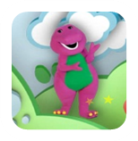
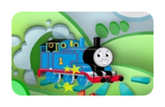
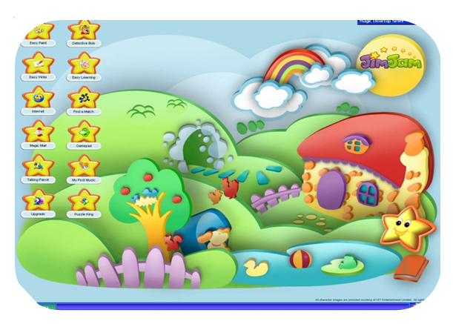
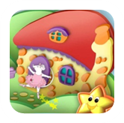
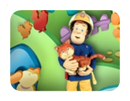
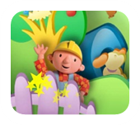
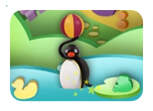
JimJam Themed Magic Desktop
Basic introduction to computer navigation for Kids aged 2-10
Educational programmes e.g. My First Music, Puzzle King, Easy Paint, FunCam, Easy Write
Kids can browse internet and send emails in pre-approved and protected walled garden
Affiliate can select and add local kids websites to browser’s favourites
Parents control when, how and which programmes are accessed
Windows Password Protection to access to regular screen / settings / files
Download and customer service issues dealt with via Magic Desktop
Operator branding can be integrated into software
Available in a variety of different languages
Interactive characters featured:

Slide 12

Why JimJam?
A fun and safe viewing space for children 24 hours a day
Market leading content with strong ratings history
Encourages imagination, creativity and self-expression through exploration, play, music and dance
Keeps children fully engaged and challenged whilst providing hours of fun!
Complimentary ancillary products create a value added service for the
  operator and subscriber
Brought to you by an experienced channel provider with long standing distribution partnerships

Slide 13
