Slide 1
ROSEMARY IKPEME
AFFILIATE MARKETING MANAGER - 09/02/2015

Slide 2
THE FACTS
Launched 1999 - now 16 years old
30 million loyal subscribers and growing
In 11 languages , across 50 territories and 4 feeds
Targeting ages 15-24 years and 25-45 years with a male skew
With full VOD support, TV Everywhere and other ancillary services
Showcasing non-stop action from surfing to mountain biking, skateboarding , snowboarding and BMX
And also features non-traditional sports and factual entertainment

Slide 3
PROGRAMMING BREAKDOWN
1. ACTION SPORTS
Featuring the very best core sports events and competitions.
2. NON-TRADITIONAL SPORTS
Expanded coverage of adrenaline-fuelled, action-packed sports beyond the norm.
3. FACTUAL ENTERTAINMENT
The widest range of factual programming and entertainment that takes viewers beyond the sports and into a world of action, adventure, skill and attitude.

Slide 4
ACTION SPORTS

Slide 5
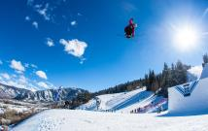
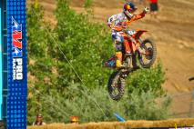
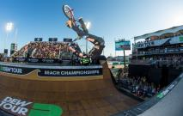
ACTION SPORTS
X GAMES
The action sports Olympics! The X Games is the longest-running event in action sports, featuring competitions in snowboarding, freeskiing and snowmobiling in the winter and skateboard, BMX, motocross and rally car racing in the summer.
AMA PRO MOTOCROSS
Coverage of all rounds of the world’s leading motocross series, featuring riders such as Ken Roczen (DE), Ryan Dungey (USA) and Brett Metcalfe (Aus).
DEW TOUR
The world’s best action sports athletes face off in three annual events covering Mountain, Beach and City. Filmed by the same team that make NBC’s Olympic coverage, Dew Tour is the destination for the very best in action sports.

Slide 6
NON-TRADITIONAL SPORTS

Slide 7
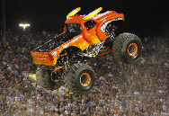
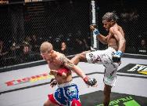
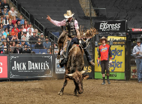
NON-TRADITIONAL SPORTS
MONSTER JAM
The biggest monster truck show in the world! High octane, thrill a minute entertainment featuring well-known brands such as Grave Digger, Scooby Doo, Backdraft and Metal Mulisha in action on huge trucks with an appetite for destruction!
EFC GLOBAL
Extreme Fighting Championship brings together the finest fighters from across the globe to fight it out in one of the world’s premiere MMA competitions.
PRO BULL RIDING
Pro Bull Riding is one of the most exciting sports entertainment events in the world. It is a contest between man and a 900 Kg horned beast that has fast become a television spectacle, reaching more than 84 countries and 600 million households each year. Only 8 seconds stand between each rider and glory..!

Slide 8
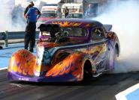
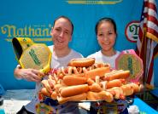
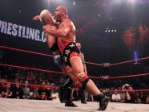
NON-TRADITIONAL SPORTS
DRAG RACING: N.H.R.A SPORTMAN SERIES
The earth-shaking, body-pumping rush that these nitro-breathing monsters produce is unlike anything else on the planet. One quarter mile is all that stands between the drivers and glory, but with speeds of well over 100 Mph, danger is ever present.
NATHAN’S HOTDOG EATING CONTEST
Historic US event where contestants try to consume as many hot dogs as possible in a ten-minute period. The current record – held by eating machine Joey Chestnut - stands at 69!
TNA GREATEST MATCHES
Amazing wrestling action from TNA featuring classic action from the world’s best wrestlers including Olympic gold medal winner Kurt Angle, Jeff Hardy and Samoa Joe.

Slide 9
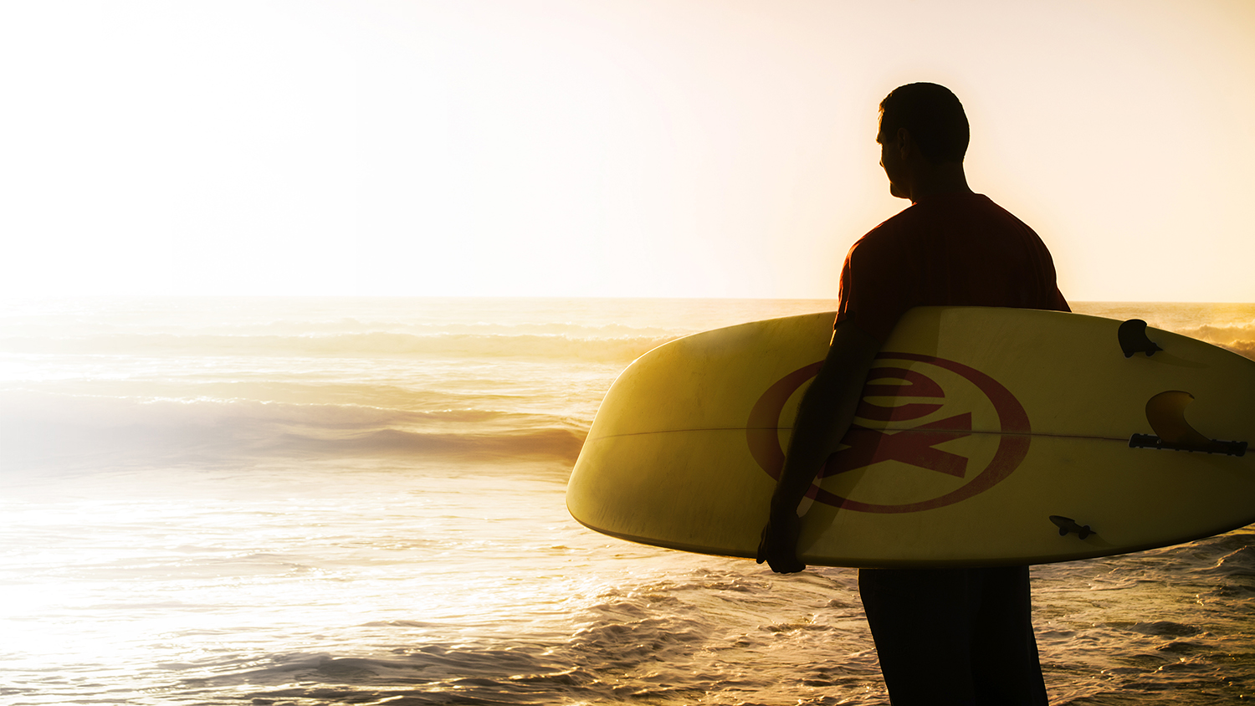
FACTUAL
ENTERTAINMENT

Slide 10
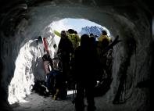
FACTUAL ENTERTAINMENT
BULLRUN – CARS AND SUPERSTARS
Cops, Cars & Superstars come together in every season of the epic Bullrun rally in this spectacular series. Featuring Ice T, Kim Kardashian, The Dudesons and Paris Hilton.
TRAVELLERS WITH SKIS
Three free-skiing adventurers travel the globe to explore different cultures through the language of skiing. Traveling to places like Morocco, Scotland, Iceland, Turkey, Greece, and Norway, they meet fascinating people, and experience the adrenaline-filled action of skiing on some of the most exotic slopes on the planet.
Fantasy Factory
Fantasy Factory features professional skateboarder and entrepreneur, Rob Dyrdek, and his partners in crime as they go about making fantasy become reality in a 25,000 square-foot warehouse in downtown Los Angeles.

Slide 11
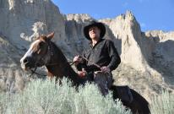
FACTUAL ENTERTAINMENT
DALLAS COWBOYS CHEERLEADERS – MAKING THE TEAM
Beautiful contestants go through a tough training camp and a series of challenges to earn a place on the world-famous Dallas Cowboy’s Cheerleading team.
Mantracker
Gritty adventure series that pits an expert tracker against two weekend warriors in a chase through remote and rugged wilderness.

Slide 12
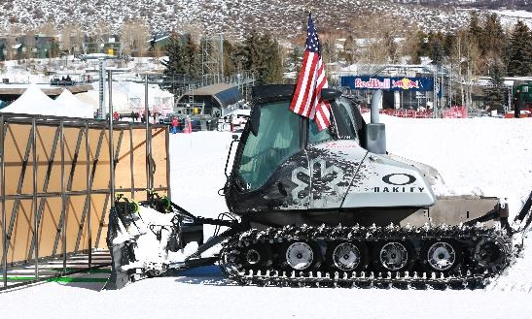
EXTREME ORIGINALS
A new strand of programming featuring territory premiering, exclusive content.
MOUNTAIN MOVERS
The crew from Snow Park Technologies travel the world building snow parks and pipes for resorts and huge competitions such as the X Games. It’s delicate, dangerous work as they drive huge snowcats across steep, deep snow to build amazing landscapes against the clock…

Slide 13
ORIGINAL & EXCLUSIVE!

Slide 14
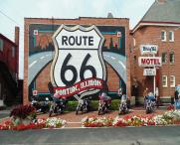
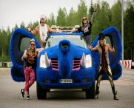
ORIGINAL AND EXCLUSIVE!
ROLLER DERBY TILL I DIE
Looking at the lives of the participants in the London Roller Girls roller derby league. As well as punishing jams on the track, we go into the lives of these wild, punk characters as they live, work and love in London.
BLOOD SWEAT & GEARS
With more travel, adventure and behind-the-scenes race action, we’ll travel with our hosts along Route 66, meet the riders who face the wall of death and follow the highs and lows of pro MX teams.
DUDESONS DO GUMBALL
The four Finnish friends take on the infamous Gumball 3000 Rally as it wends its way through Europe from Scandinavia to Monaco. Pranks, parties and a whole lot of driving in a purple elephant make it ride to remember

